Slide 1

Optimize Azure Synapse SQL Pools
{ |  | }
 | Azure Synapse SQL Pools

Slide 2
Database Scaling
Module 4

Slide 3
Learning Units covered in this Module
Lesson 1: Scale Concepts
Lesson 2 Performance and Scaling
Lesson 3: Pause and Resume
Notes:
Lesson 2: Performance improvements to expect when scaling
Different types of queries improve differently
Lesson 3: How can pause/resume be affected in duration
Lesson 4: How replicated tables are affected during scaling

Slide 4
Lesson 1: Scale Concepts

Slide 5

Objectives
After completing this lesson, you will be able to:
Understand the following topics:
How scaling works
The concept of Data Warehouse Units (DWU)

Slide 6


Separation of Compute from Storage
Control
Compute
Premium Storage
Notes:
We always have 60 distributions
You can ramp up or down compute power without affecting your storage
Differentiator with Amazon Redshift: when we reattach databases, we can scale much faster – no need to destroy/recreate the cluster
https://docs.microsoft.com/en-us/azure/synapse-analytics/sql-data-warehouse/sql-data-warehouse-manage-compute-overview

Slide 7
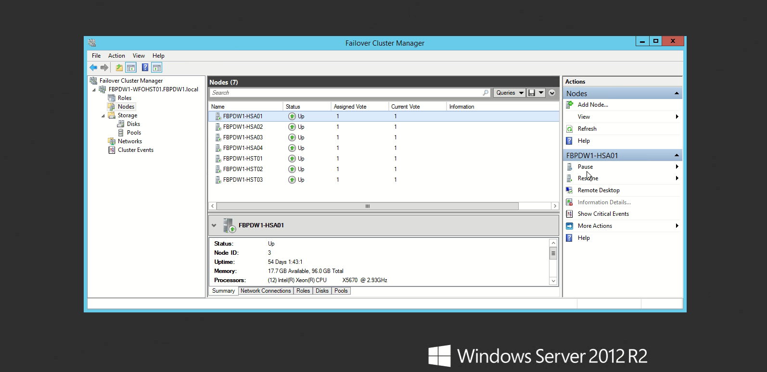
Notes:
For INTERNAL USE ONLY !!!

Slide 8
Independently Scale Compute
Control
Compute
Premium Storage
Notes:
Scaling happens quickly (seconds to minutes), but compute is offline while you are scaling
Scale up compute during high volume times – scale down during low volume
Possibly mention updates during scaling – need more info on this topic
Compute scales from DW100, which is 1 nodes to DW30000, which is 60 nodes
https://docs.microsoft.com/en-us/azure/synapse-analytics/sql-data-warehouse/sql-data-warehouse-manage-compute-overview#scaling-compute
The scaling workflow
When you start a scale operation, the system first kills all open sessions, rolling back any open transactions to ensure a consistent state. For scale operations, scaling only occurs after this transactional rollback has completed.
For a scale-up operation, the system detaches all compute nodes, provisions the additional compute nodes, and then reattaches to the storage layer.
For a scale-down operation, the system detaches all compute nodes and then reattaches only the needed nodes to the storage layer.
https://docs.microsoft.com/en-us/azure/synapse-analytics/sql-data-warehouse/what-is-a-data-warehouse-unit-dwu-cdwu#the-scaling-workflow
What does not persist Scaling:
Replicated table cache
Adaptive cache

Slide 9
Geo Replication
Notes:
SQL Data Warehouse creates snapshots on your online data warehouses every four to eight hours and
keeps each snapshot for seven days. You can restore your online database to one of the restore points in the past seven days.
Every 24 hours, SQL Data Warehouse stores the full data warehouse in Standard storage. (GEO)
Redundant storage is on standard storage
The RPO for a geo-restore is 24 hours
https://docs.microsoft.com/en-us/azure/cloud-adoption-framework/migrate/azure-best-practices/analytics/azure-synapse#:~:text=In%20addition%20to%20the%20snapshots%20described%20earlier%2C%20Azure,other%20region%20where%20Azure%20Synapse%20Analytics%20is%20supported.
User-defined restore points are available for seven days and are automatically deleted on your behalf. You cannot change the retention period of user-defined restore points. 42 user-defined restore points are guaranteed at any point in time so they must be deleted before creating another restore point.
SQL pool deletes a restore point when it hits the 7-day retention period and when there are at least 42 total restore points (including both user-defined and automatic).
Strategy – If you want more than 7 day retention – restore to a new database and pause
https://docs.microsoft.com/en-us/azure/sql-data-warehouse/sql-data-warehouse-backups

Slide 10
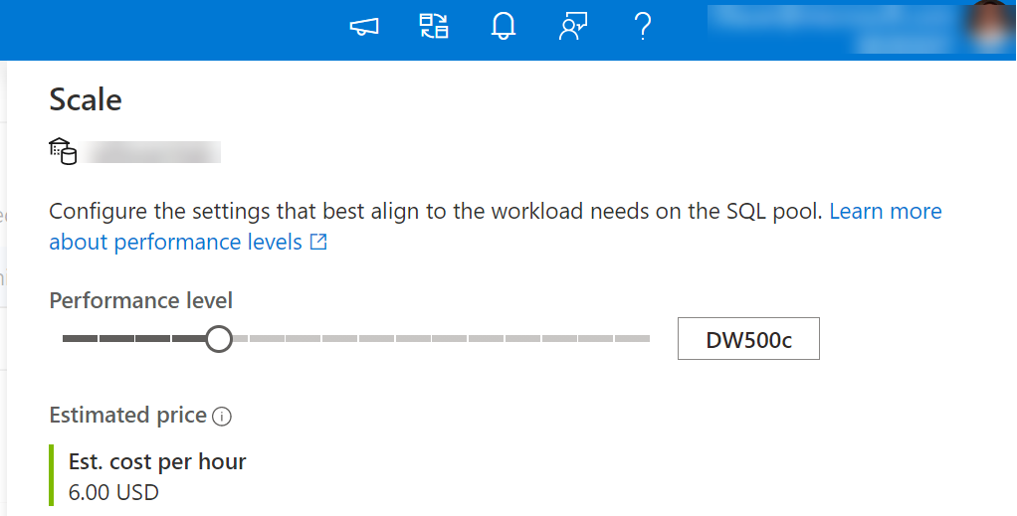
Introducing Data Warehouse Units
CPU
ALTER DATABASE ContosoDW
MODIFY
(service_objective ='DW1000c');
RAM
I/O
Notes:
Billing for compute and storage is billed separate
Data warehouse units defined by amounts of CPU and RAM – compute power scales up or down as you scale up or down to a particular DWU
(Need more info on how I/O is affected)
Offers predictable and scalable performance
You can scale using DSQL command, Azure portal, PowerShell, APIs (possibly others)
The following DW operations scale linearly with DWU’s: Scan/Aggregation, Load, CTAS
When you look at DWU Used in the portal, you are basically looking at the maximum of either Memory or CPU
Scaling can be done in the Azure Portal and the Azure Synapse workspace
Scale points are limited to equally dividing the 60 distributions between Compute nodes,
E.g. 7 Compute nodes (DW3500c) doesn’t make sense, as 60 distributions can’t be evenly divided across 7 compute nodes – 6 compute node would process 9 distributions, 1 compute node would process 6 distributions.
Note that DW100c – DW400c is typically used for development and test environments, these levels are not recommended for production workloads.
What are Data Warehouse Units
A Synapse SQL pool represents a collection of analytic resources that are being provisioned. Analytic resources are defined as a combination of CPU, memory, and IO.
These three resources are bundled into units of compute scale called Data Warehouse Units (DWUs). A DWU represents an abstract, normalized measure of compute resources and performance.
A change to your service level alters the number of DWUs that are available to the system, which in turn adjusts the performance, and the cost, of your system.
For higher performance, you can increase the number of data warehouse units. For less performance, reduce data warehouse units. Storage and compute costs are billed separately, so changing data warehouse units does not affect storage costs.
Performance for data warehouse units is based on these data warehouse workload metrics:
How fast a standard SQL pool query can scan a large number of rows and then perform a complex aggregation. This operation is I/O and CPU intensive.
How fast the SQL pool can ingest data from Azure Storage Blobs or Azure Data Lake. This operation is network and CPU intensive.
How fast the CREATE TABLE AS SELECT T-SQL command can copy a table. This operation involves reading data from storage, distributing it across the nodes of the appliance and writing to storage again. This operation is CPU, IO, and network intensive.
https://docs.microsoft.com/en-us/azure/synapse-analytics/sql-data-warehouse/what-is-a-data-warehouse-unit-dwu-cdwu

Slide 11
Lesson 2: Performance and Scaling in Azure Synapse SQL Pools

Slide 12
Objectives
After completing this lesson, you will be able to:
Understand the following topics:
What is compute scaling and how it works

Slide 13
Compute Scaling Factors
Concurrency
Transaction size
Load
Memory
Data Warehouse Unit (DWU)
Notes:
These are the factors that impact what DWU you may want to scale to
Concurrency scales with DWUs
Heavier workload based on these factors requires more compute (ie. These factors are how you determine how “large” your workload is)
Transaction size: max individual transaction size increases as DWUs increase – more resources (memory, TempDB, etc) implies larger transactions can be executed
Load: max external readers increases as DWUs increase

Slide 14
Starting point: Sizing by Capacity
Recommended starting point
Flexibility to select any range of DWUs
>160 TBs
80-160 TBs
60-80 TBs
48-60 TBs
36-48 TBs
20-36 TBs
16-20 TBs
12-16 TBs
8-12 TBs
4-8 TBs
0-4 TBs
100
200
300
400
500
600
1000
1200
1500
2000
3000
6000
Notes:
Estimate of a starting point for DWUs
Evaluate the performance of your system at the starting point to determine if you need to be higher or lower
Remember, different activity levels through the lifecycle of your workload may require different DWUs (scale up and scale down)
This number could be very off depending on whether or not this is a production instance and what kind of performance is required. Testing required.
Note that DW100c – DW400c is typically used for development and test environments, these levels are not recommended for production workloads.
https://docs.microsoft.com/en-us/azure/synapse-analytics/sql-data-warehouse/sql-data-warehouse-manage-compute-overview

Slide 15
Concurrency: Queries
QID
QID
32
active queries
@DW1000c
1024
open sessions
QID
QID
QID
QID
Notes:
There is a maximum of 1024 sessions (at time of this writing) at any DWU
The maximum number of active queries (At DW1000 at the time of this writing) is 32 (side-note: work is being done to increase this)
If there are already 32 active queries, subsequent queries will be queued – first in first out
Read for current numbers:
https://docs.microsoft.com/en-us/azure/synapse-analytics/sql-data-warehouse/resource-classes-for-workload-management
https://docs.microsoft.com/en-us/azure/synapse-analytics/sql-data-warehouse/memory-concurrency-limits

Slide 16
Data Loading
DWU | Max External Readers | Max Writers
DW500c | 8 | 60
DW1000c | 16 | 60
DW1500c | 24 | 60
DW2000c | 32 | 60
DW2500c | 40 | 60
DW3000c | 48 | 60
DW5000c | 80 | 60
DW6000c | 96 | 60
DW7500c | 120 | 60
DW10000c | 160 | 60
DW15000c | 240 | 60
DW30000c | 480 | 60
8 Readers per Node
Use mediumrc+ for high DWU loads
Notes:
When loading – the max number of external readers increases with DWUs
This allows you more parallelism in your loads
There are 8 readers per node, so the number increased with that
Tutorial: Load the New York Taxicab dataset:
https://docs.microsoft.com/en-us/azure/synapse-analytics/sql-data-warehouse/load-data-from-azure-blob-storage-using-polybase

Slide 17
Load Scaling
30-32 MB/Sec/Node
110-115 GB/Hour/Node
Notes:
(this appears to be polybase numbers, need to talk about exception for bcp, ssis, or anything that goes through control node)
X-axis is number of nodes
Y axis is mb/sec
To minimize latency, collocate your storage layer and your SQL pool.
For fastest loading speed, run only one load job at a time.
To run loads with appropriate compute resources, create loading users designated for running loads. Classify each loading user to a specific workload group.
To achieve the fastest loading speed for moving data into a SQL pool table, load data into a staging table. Define the staging table as a heap and use round-robin for the distribution option.
Best practices: https://docs.microsoft.com/en-us/azure/synapse-analytics/sql-data-warehouse/guidance-for-loading-data#increase-batch-size-when-using-sqlbulkcopy-api-or-bcp
Azure SQL DW Gen2: Data Movement Enhancements https://youtu.be/PlyQ8yOb8kc

Slide 18

Loading Delimited Text
A compressed text file cannot be read
in parallel
Splitting data across multiple files maximizes load performance
Notes:
This is referring to polybase (like blob)
If the text file is not compressed, it will split it and load it in parallel
If the text file is compressed, you need to manually split it up across multiple files to achieve parallelization

Slide 19
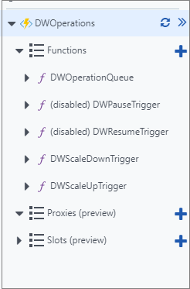
Use Azure Functions to Manage Compute Resources
Deploy timer-based scaling
Change the compute level
Use trigger function
Notes:
Currently, there are only two scaling functions included within the template. With these functions, during the course of a day, you can only scale down once and up once. For more granular control, such as scaling down multiple times per day or having different scaling behavior on the weekends, you need to add another trigger.
https://docs.microsoft.com/en-us/azure/synapse-analytics/sql-data-warehouse/manage-compute-with-azure-functions

Slide 20
Lesson 3: Pause and Resume

Slide 21
Objectives
After completing this lesson, you will be able to:
Understand the following topics:
How pause and resume works and it affects on workload

Slide 22
Pause and Resume Workload
Control
Compute
Premium Storage
Notes:
To save costs, you can pause and resume compute resources on-demand.
The data warehouse is offline (unreachable) while it is paused
Pause during times of inactivity
While paused, you are not charge for compute (still charged for storage – including backup/replication)
Pause and resume happens in a similar timeframe to scaling

Slide 23
Pausing Compute in SQL Pool
DW2500c
01
02
03
04
05
06
07
08
09
10
11
12
13
14
15
16
17
18
19
20
21
22
23
24
25
26
27
28
29
30
31
32
33
34
35
36
37
38
39
40
41
42
43
44
45
46
47
48
49
50
51
52
53
54
55
56
57
58
59
60
Notes:
When you pause, the distributions are untouched.
Quick start https://docs.microsoft.com/en-us/azure/synapse-analytics/sql-data-warehouse/pause-and-resume-compute-powershell

Slide 24
Resuming Compute in SQL Pool
DW2500c
01
02
03
04
05
06
07
08
09
10
11
12
13
14
15
16
17
18
19
20
21
22
23
24
25
26
27
28
29
30
31
32
33
34
35
36
37
38
39
40
41
42
43
44
45
46
47
48
49
50
51
52
53
54
55
56
57
58
59
60
Notes:
While it’s paused you are not using any compute power
When you resume, you resume to the same DWU
Cannot scale while paused

Slide 25
Knowledge Check – Scaling
What does DWU consists of
What happens when you scale up
What happens when you scale down
Is the compute resource reachable when it is paused
Are you charged while the compute resource is paused?
Notes:
What does DWU consists of: DWU is a combination of your CPU, Memory and IO.
What happens when you scale up: For a scale-up operation, the system detaches all compute nodes, provisions the additional compute nodes, and then reattaches to the storage layer.
What happens when you scale down: For a scale-down operation, the system detaches all compute nodes and then reattaches only the needed nodes to the storage layer.
Is the compute resource reachable when it is paused: The data warehouse is offline (unreachable) while it is paused
Are you charged while the compute resource is paused? While paused, you are not charge for compute (still charged for storage – including backup/replication)

Slide 26
Microsoft

